Slide 1


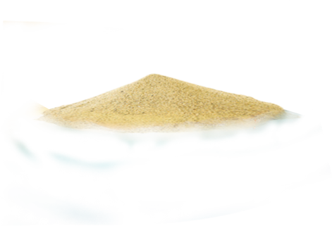

TRIP PLANNER
Plan Your Dream Journey

Slide 2
OUR PURPOSE
01
04
Suggest Changes
Find Places
We Provide our customers with many options to sort and find the places with perfect match
Our customer can suggest changes and give rating to any package they like and we as a team comply with it and create the best package
02
Explore More
05
Be at Ease
We provide more information about the places like hotels, tourist places near it and some pictures
We are always available and reply to every customer for any queries and we have also provided all our contact information
03
Utilize resources
06
Hassle free trip
We plan to utilize Technology fully and give best deals to our customers
We have planned everything like vehicle, meals for you so don’t worry you will never have to do a thing on your trip

Slide 3

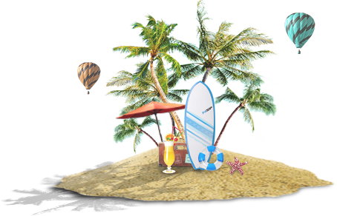
CONTRIBUTORS
Saurabh Singh Balke 20BCS201
Shivam Agrahari 20BCS205
Sarthak Jain 20BCS198

Slide 4


ABOUT US
TRIP PLANNER
is a DBMS web application to facilitate and promote travelling.
The application can act as single solution to cater to all needs of the trip.
It provides all the information the place like hotel details and food
expenditures, tourist places, travel expenditure.
We provide you with best packages with best price an under this we cover all your
expenditure on food, vehicles and resting places. We will also provide you with
guides for your ease.
ADMIN
ADMIN
ADMIN
Saurabh Singh Balke
20bcs206@iiitdmj.ac.in.
Shivam Agrahari
20bcs205@iiitdmj.ac.in
Sarthak Jain
20bcs198@iiitdmj.ac.in

Slide 5






Software Stack
VS CODE
XAMPP
GOOGLE CHEOME
Min 1.6Ghz processor,
1GB RAM and 500MB Storage.
512MB RAM and 250MB Storage
Windows 7 or later and
Intel Pentium 4 or later
Use Visual Studio Code to write your Program and check errors using VS-extensions.
Connect to Your database Using xampp application and see the results of queries
View live demonstration of your project through chrome and see a final view
READY TO GO

Slide 6
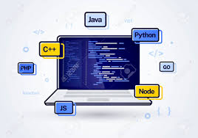





Programming Environment
CSS
01
Cascade sheet styling used to give beautiful designs and colors to our project.
Languages Used
HTML
02
Skeletal structure of our project as it and is used in almost all places.
In modern world technology has made our life easier and one of its major part is computer. We can communicate with computer easily using programming language. In our project we have used 5 computer languages
PHP
03
Used to check conditions, runs loop to make our program easy and always keeps track of a user or admin
MYSQL
JAVASCRIPT
Used to write queries to get required data from database.
Used to make our project lively

Slide 7




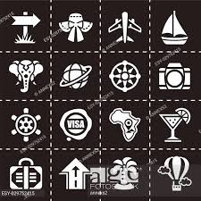
HOW TO
01
Find Places
Search for your preferred places and packages and book get a plane to visit that place
02
Find a place to fulfill your physical needs
Find hotels that suit your preference and price and get a package to book a resting place and vehicle
03
Visit nearby iconic places
Search all nearby places you like and book it to get a hassle free trip with no worry for food shopping time and vehicle. Get to eat the most popular cuisines of the places you visit

Slide 8

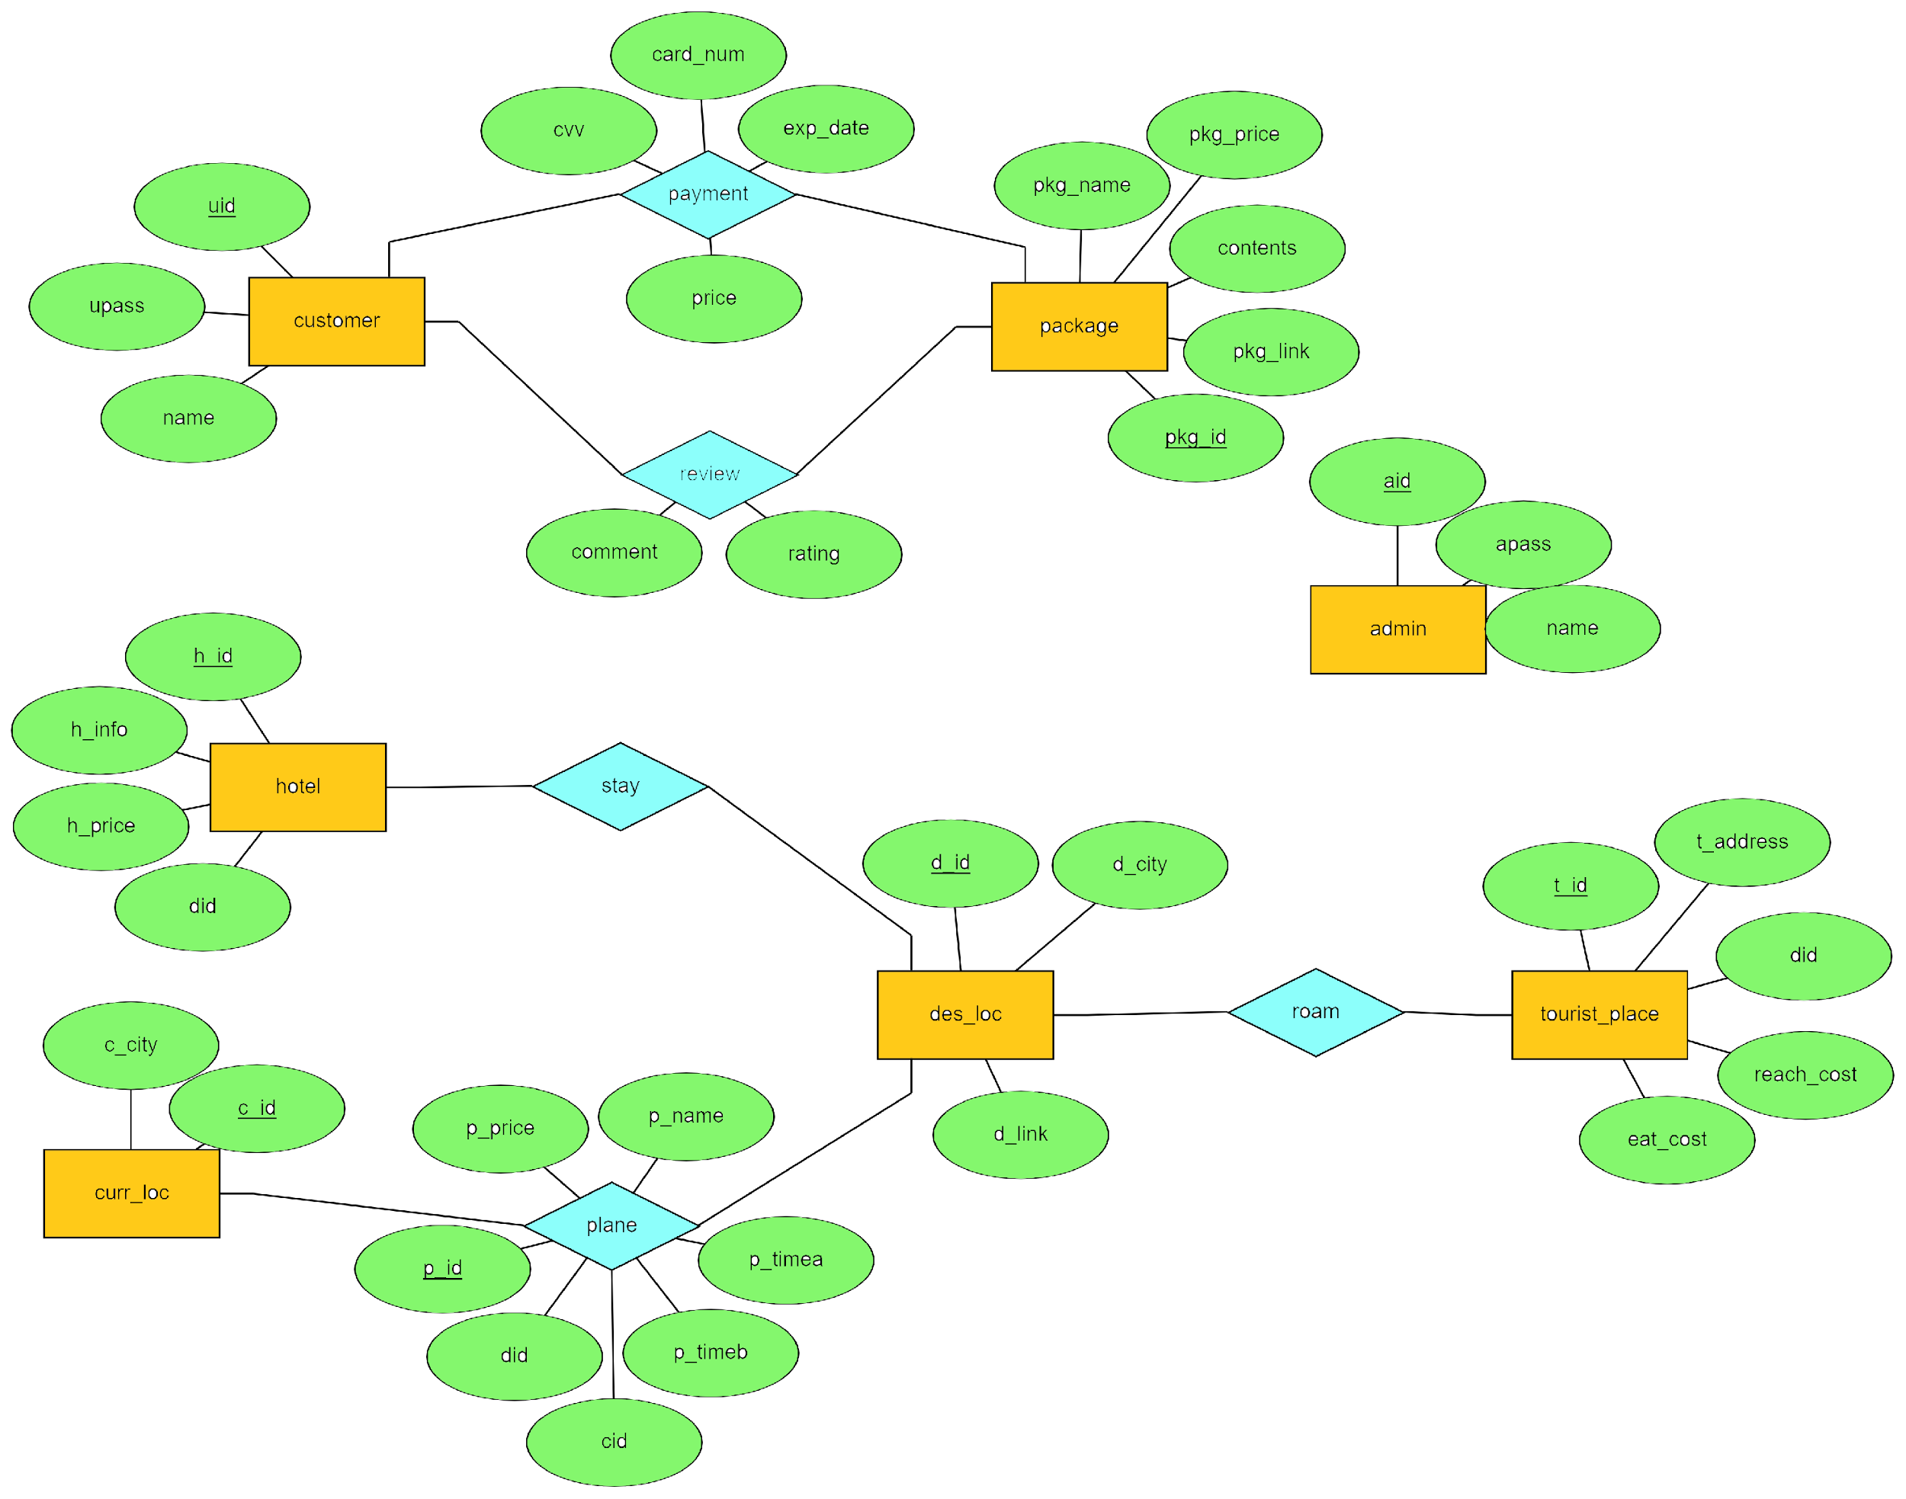
E-R DIAGRAM

Slide 9
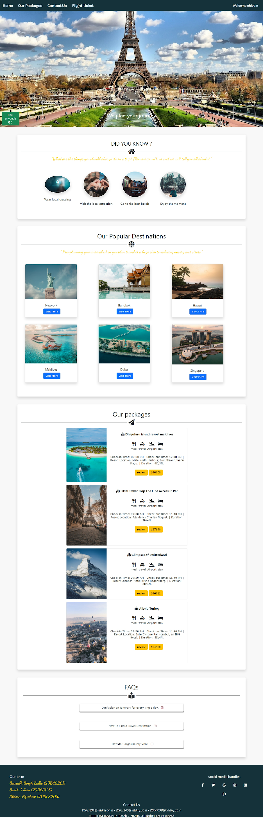
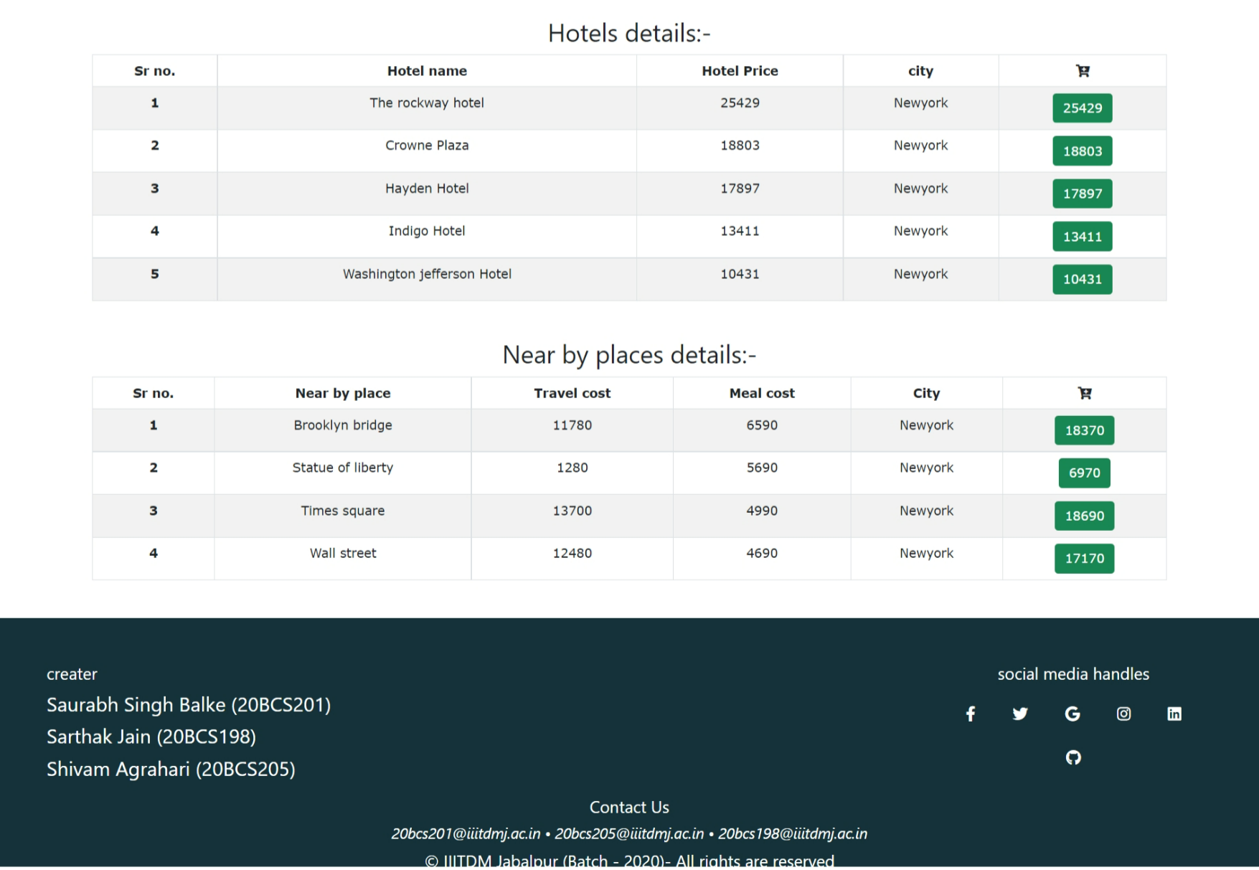
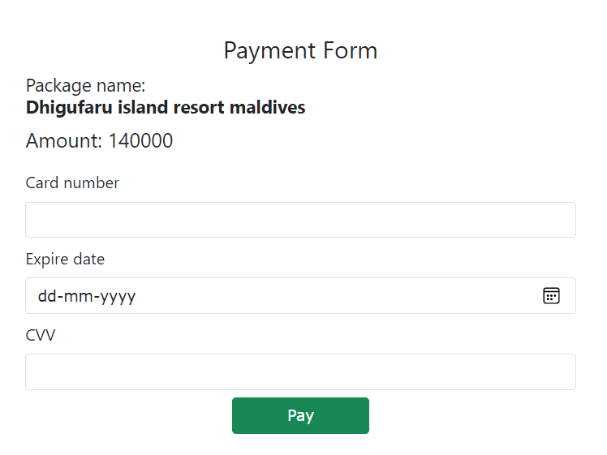
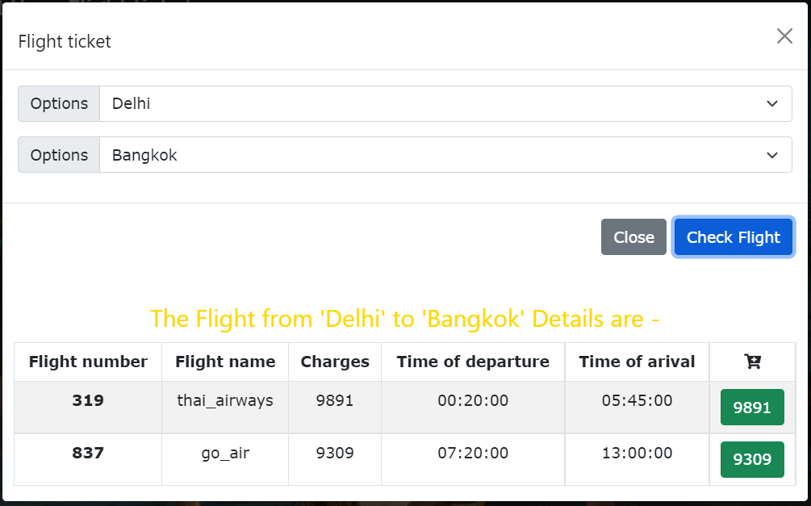
USER PANEL

Slide 10
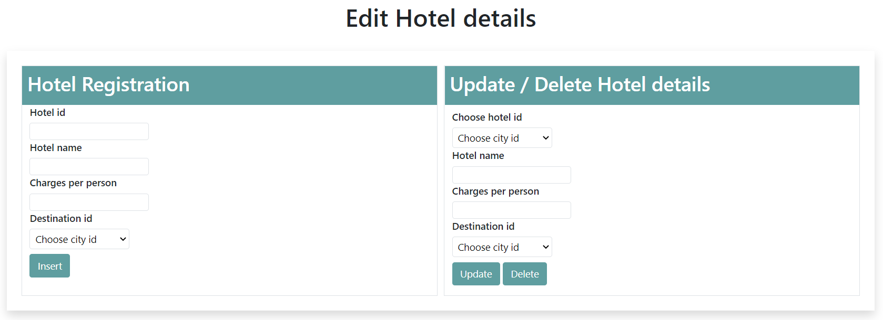
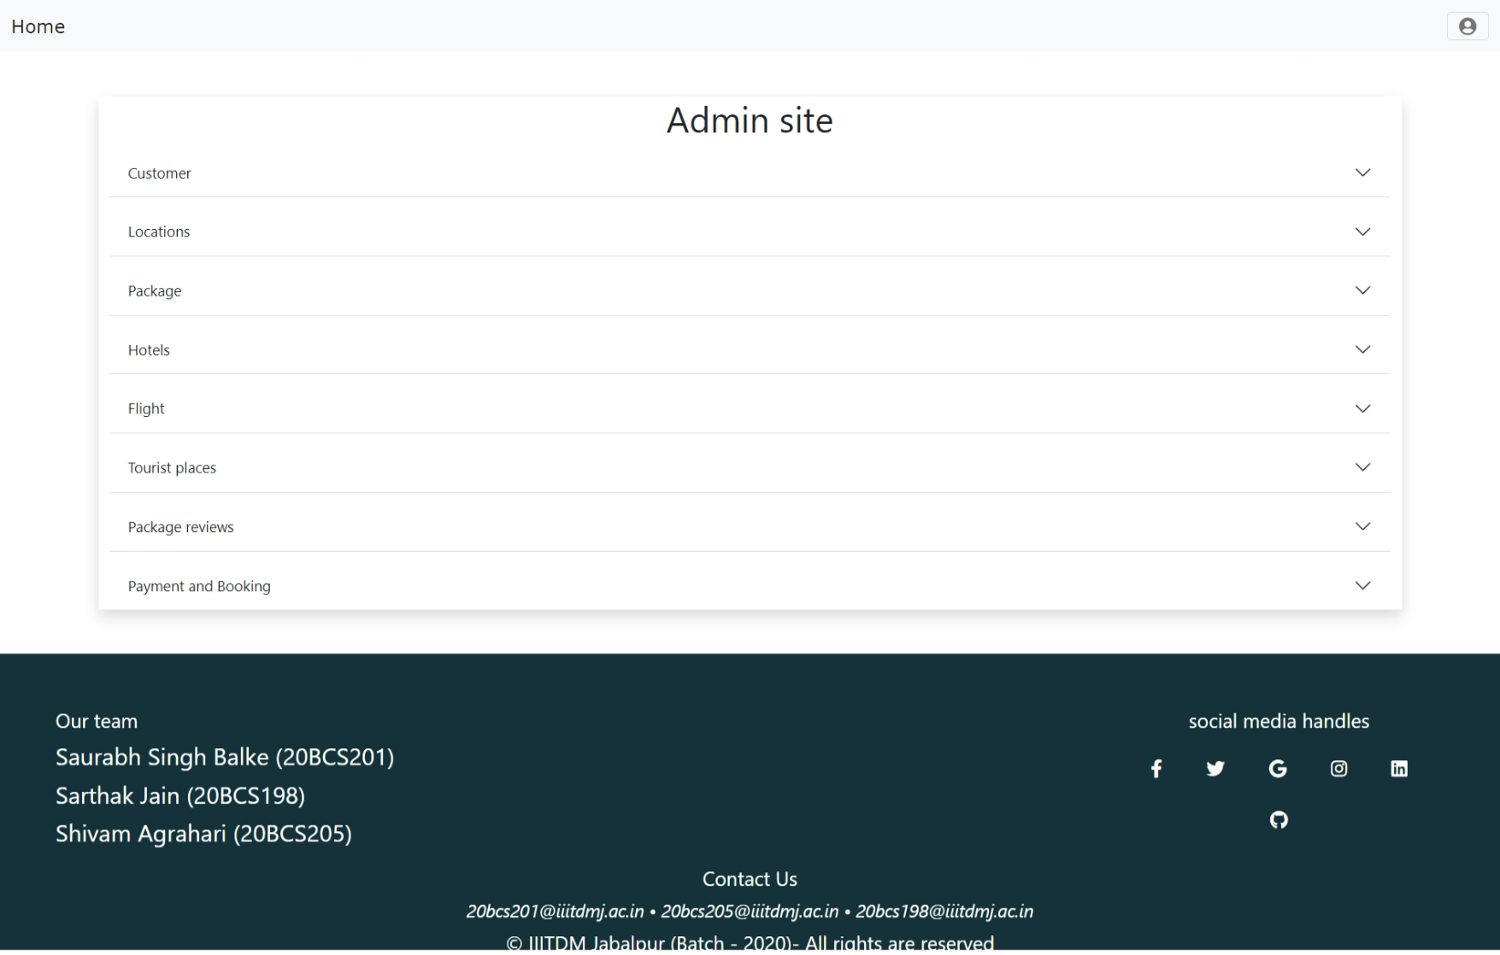

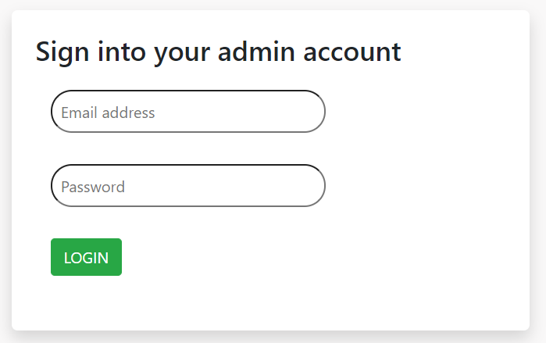
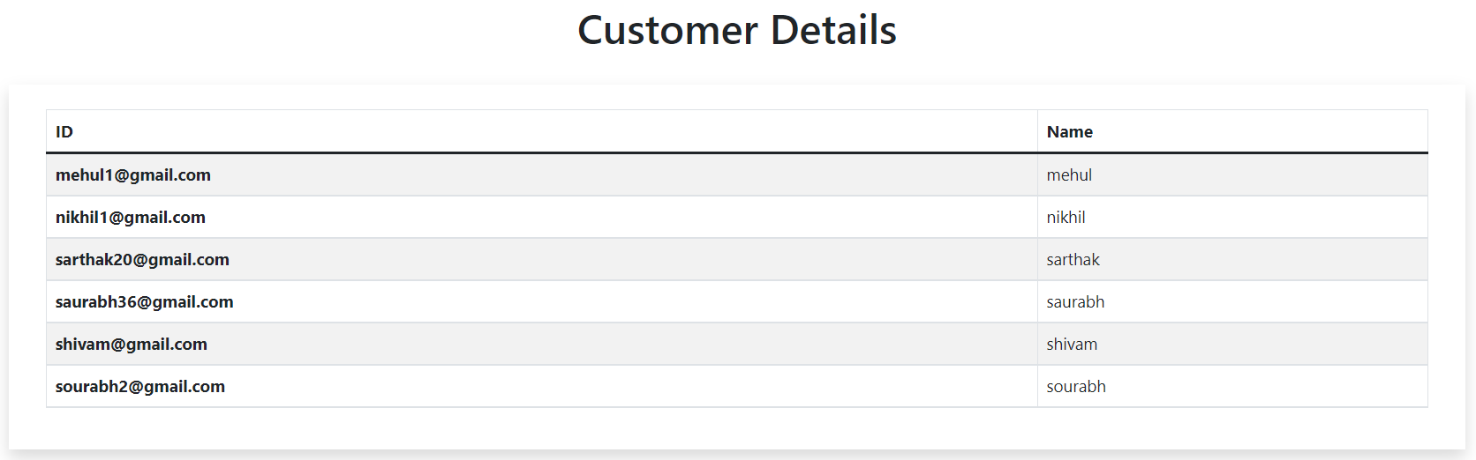
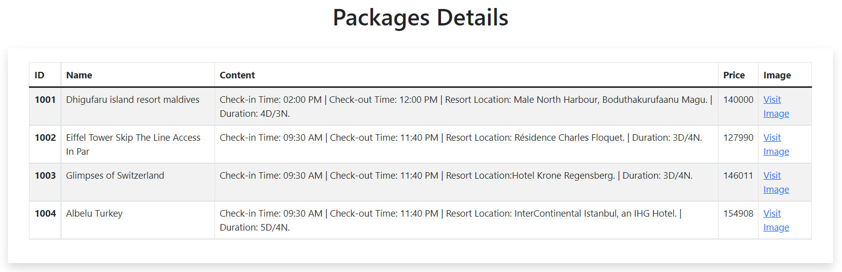
ADMIN PANEL

Slide 11
Thank You

